Slide 1

Topics Covered: Control Statements in Python
Semester: 3rd Paper code: AIML203 Subject: Foundations of Data Science L

Slide 2
PREREQUISITE OF TOPIC: Student should be aware of data structures in python (list, tuple, string, dictionaries, set).
OBJECTIVES:
To improve programming skills in engineering students
Provide career orientation in field of computer science and engineering.
OUTCOMES:
Write code that employ decision structures, including those that employ sequences of decision and nested decisions.
Design simple applications having iterative nature.

Slide 3
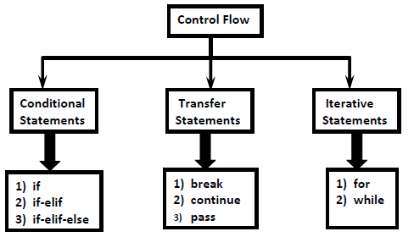
CONTROL STATEMENTS:
Control statements describes the order in which statements will be executed at runtime.
Types are:
1. Sequence
2. Selection
3. Iteration
4. Transfer

Slide 4
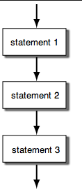
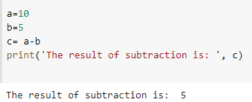
SEQUENCE
Sequence is the default control structure.
Instructions are executed one after another.
FLOWCHART:
EXAMPLE:

Slide 5
SELECTION / DECISION MAKING STATEMENTS
The selection statements are also known as Decision control statements or branching statements.
The selection statement allows a program to test several conditions and execute instructions based on which condition is true.
Some Decision Control Statements are:
Simple if
if-else
if-elif-else

Slide 6
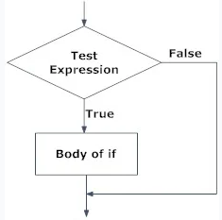

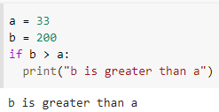
IF STATEMENT
The program evaluates the test expression and will execute statement(s) only if the test expression is True.
If the test expression is False, the statement(s) is not executed.
FLOWCHART:
SYNTAX:
EXAMPLE:

Slide 7
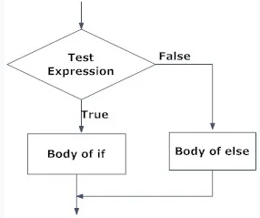
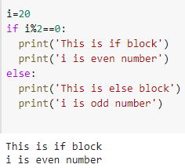
IF ELSE STATEMENT
Used to execute both true part and false part of a given condition.
If condition is true, if block is executed otherwise the else block is executed.
FLOWCHART:
EXAMPLE:
SYNTAX:
if(condition):
#Executes this block
if the condition is true
else:
#Executes this block
if the condition is false

Slide 8
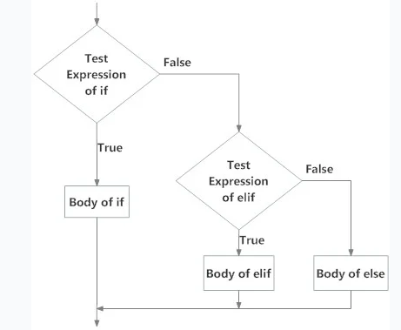
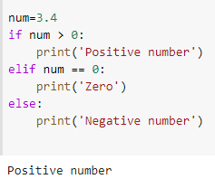
If-Elif-Else Statement
It checks the if statement condition.
If that is false, the elif statement is evaluated.
In case the elif condition is false, the else statement is evaluated.
SYNTAX:
if (condition):
statement
elif (condition):
statement
.
.
else:
Statement
EXAMPLE:
FLOWCHART

Slide 9
ITERATIVE STATEMENTS
Loops can execute a block of code number of times until a certain condition is met.
The iteration statements are also called as loops or Looping statements.
Python supports 2 types of iterative statements.
1) for loop
2) while loop

Slide 10
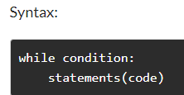
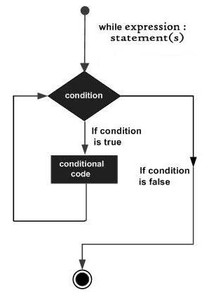
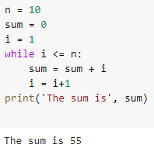
WHILE LOOP
It continually executes the statements(code) as long as the given condition is TRUE.
It first checks the condition and then jumps into the instructions.
FLOWCHART:
EXAMPLE:

Slide 11
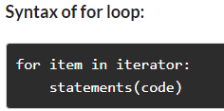
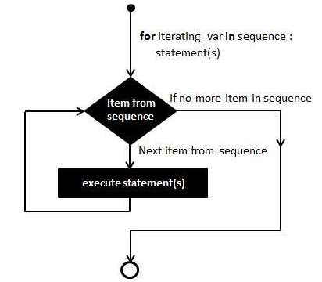
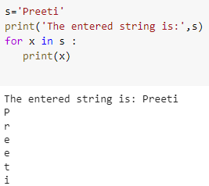
FOR LOOP
A for loop is used to iterate over a sequence like lists, type, dictionaries, sets, or even strings.
Loop statements will be executed for each item of the sequence.
FLOWCHART
EXAMPLE

Slide 12
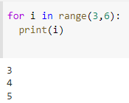
FOR LOOP---RANGE KEYWORD
The range() function returns a sequence of numbers, starting from 0 by default, and increments by 1 (by default), and ends at a specified number.
EXAMPLE:
SYNTAX:
range(start, stop, step)

Slide 13
JUMPING / TRANSFER STATEMENTS
Transfer statements alter the way a logic gets executed.
These statements are often used in loops for and while.
They are of three types:
break
continue
pass

Slide 14
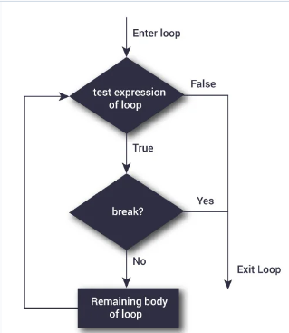

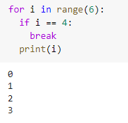
BREAK
FLOWCHART
It terminates the current loop if certain condition is met and resumes execution at the next statement following the loop.
EXAMPLE

Slide 15
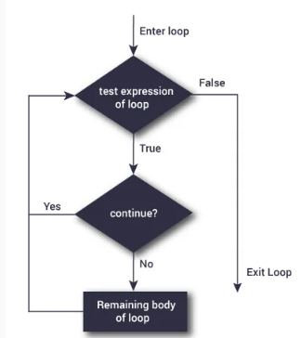
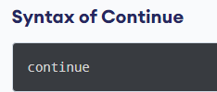
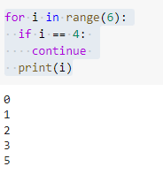
CONTINUE
Used to skip the rest of the code inside a loop for the current iteration only.
Loop does not terminate but continues on with the next iteration.
FLOWCHART
EXAMPLE

Slide 16
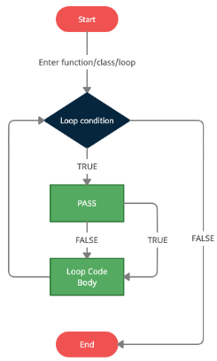
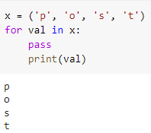
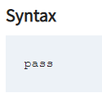
PASS STATEMENT
Python pass is a null statement.
When the Python interpreter comes across the across pass statement, it does nothing and is ignored.
FLOWCHART
EXAMPLE

Slide 17
INTERVIEW QUESTIONS
1.Difference between break and continue statement?
When break keyword is encountered, it will exit the loop. In case of continue keyword, the
current iteration that is running will be stopped, and it will proceed with the next iteration.
2.What are loop interruption statements in Python? There are two types of loop interruption statements in Python that let users terminate a loop
iteration prematurely, i.e., without letting the loop run its full iterations. Ex: break and continue
3.Under what circumstances would you use a while statement rather than for? The while statement is used for simple repetitive looping and the for statement is used when one
wishes to iterate through a list of items, such as database records, characters in a string, etc.
Q 4: What is the output of the following snippet?
i=1
while True:
if i%3 ==0: break
print(i,end='')
i +=1
Output: 12
Q5: List the control structures in Python.
Ans. (i) Sequential
(ii) Alternative or Branching
(iii) Iterative or Looping

Slide 18
PROBLEMS FOR PRACTICE
Problem 1: https://www.hackerrank.com/challenges/kangaroo/problem
Problem 2: https://www.hackerrank.com/challenges/apple-and-orange/problem
Problem3: https://www.hackerrank.com/challenges/grading/problem
Problem 4: https://www.hackerrank.com/challenges/cats-and-a-mouse/problem
Problem 5: https://www.hackerrank.com/challenges/electronics-shop/problem
Problem 6: https://leetcode.com/problems/two-sum/
Problem 7: https://leetcode.com/problems/longest-substring-without-repeating-characters/
Problem 8: https://leetcode.com/problems/reverse-integer/
Problem 9: https://leetcode.com/problems/palindrome-number/
Problem 10: https://leetcode.com/problems/container-with-most-water/
Problem 11: https://www.codechef.com/submit-v2/CABS
Problem 12: https://www.codechef.com/submit-v2/VOLCONTROL
Problem 13: https://www.codechef.com/submit-v2/BATTERYLOW
Problem 14: https://www.codechef.com/submit-v2/MANIPULATE
Problem 15: https://www.codechef.com/submit-v2/CHFDBT

Slide 19
REFERENCES
https://www.softwaretestinghelp.com/python/python-control-statements/
https://www.analyticsvidhya.com/blog/2021/09/loops-and-control-statements-an-in-depth-python-tutorial/
https://www.w3schools.com/python/python_conditions.asp
https://cuny.manifoldapp.org/read/how-to-code-in-python-3/section/8adf4bec-a6ca-4a11-8c8d-4cf4052d5ac4
Video Lectures
https://www.youtube.com/watch?v=AaoqKlYCbSk
https://www.youtube.com/watch?v=dDzkt5OLeRY
Books
Lee KD. Python programming fundamentals. London, New York: Springer; 2011.
Bogdanchikov A, Zhaparov M, Suliyev R. Python to learn programming. InJournal of Physics: Conference Series 2013 Apr 10 (Vol. 423, No. 1, p. 012027). IOP Publishing.

